Slide 1
Introduction
Medical Director New Dawn Recovery
Medical Director CRC methadone treatment program
Psychiatrist Cares center for HIV treatment
Certified in Adult Psychiatry and Addiction Psychiatry
Volunteer clinical faculty UC Davis

Slide 2
Overlaping Circuits in Obesity and Chemical Dependency

Slide 3
Dopamine in addiction
All addictive drugs increase Dopamine in the limbic system

Slide 4
Reductions in dopamine type 2 receptors
Common post cocaine addiction
Common post meth addiction
Common post alcohol addiction
Common post methamphetamine addiction

Slide 5
What does dopamine do
Signals what is referred to as salience ie
“LOOK PAY ATTENTION TO THIS IT IS IMPORTANT”
Dopamine stays in the synape less than 50 microseconds before being recycled by the dopamine transporter.

Slide 6
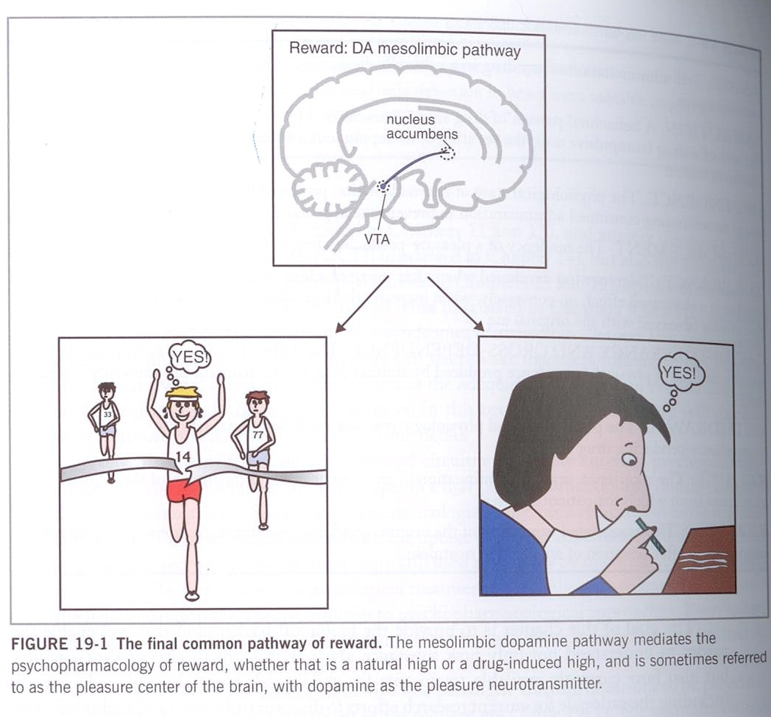

Slide 7
KEY POINTS
Dopamine is important in everything that feels good.
If you feed a hungry rat, you see a spike in dopamine
If you allow a rat to mate, you see an even bigger spike in dopamine

Slide 8
Natural Rewards Elevate
Dopamine Levels
FOOD
SEX
200
200
NAc shell
150
150
DA Concentration (% Baseline)
100
100
15
% of Basal DA Output
Empty
10
50
Copulation Frequency
Box
Feeding
5
0
0
0
60
120
180
Scr
Scr
Scr
Scr
Time (min)
Bas
Female 1 Present
Female 2 Present
Sample
Number
1
2
3
4
5
6
7
8
9
10
11
12
13
14
15
16
17
Mounts
Intromissions
Ejaculations
Source: Di Chiara et al.
Source: Fiorino and Phillips

Slide 9
KEY POINTS
The same is true with drugs of abuse.
With cocaine you see you get an intense spike of dopamine after administration.
Alcohol works on many systems in the brain, but it too attributes some of it effect to dopamine in this area of the brain.
Nicotine works similarly
Amphetamine produces and extremely greater effect.

Slide 10
Effects of Drugs on Dopamine Release
1500
1000
500
0
METHAMPHETAMINE
COCAINE
400
Accumbens
Accumbens
300
DA
DOPAC
% of Basal Release
HVA
% Basal Release
200
100
0
1
2
3hr
0
Time After Methamphetamine
Time After Cocaine
250
NICOTINE
250
Accumbens
ETHANOL
200
Accumbens
200
Dose (g/kg ip)
Caudate
0.25
150
0.5
% of Basal Release
1
% of Basal Release
2.5
100
150
100
0
0
1
2
3 hr
0
Time After Nicotine
0
1
2
3
4hr
Time After Ethanol
Source: Shoblock and Sullivan; Di Chiara and Imperato

Slide 11
Beyond Dopamine
Addiction is also contributed to by inadequate executive control in the orbital frontal cortex and cingulate gyrus

Slide 12
Brain Dopamine and Obesity
Dopamine appears to regulate food/reward in the meso-limbic circuitry of the brain
Too few D2 receptors play a role
Drugs that block D2 receptors increase appetite
Drugs that increase brain dopamine concentration are anorexogenic

Slide 13
What is BMI
Body Mass index
Wt/Ht determination
Normal weight=18.5-24.9
25-29.9=Overweight
30 or greater=Obese 31 percent of americans

Slide 14
But not the whole story
If given to anyone drugs of abuse increase Dopamine however most will not become addicted
Brain Imaging studies show people who become addicted have a lower number of Dopamine receptors and a smaller increase in dopamine levels and less control over repetitive drug seeking

Slide 15
Dopamine and Obesity
There is lower Dopamine D2 receptor availability in the striatum of obese individuals than in normal controls
Low levels of D2 receptors are also found in individuals who are cocaine addicted,alcohol addicted and opiate addicted

Slide 16
Possibilities
Eating is highly reinforcing
Feeding increases extracellular dopamine concentration in the nucleus accumbens which is also the pathway for reinforcement of drugs of abuse
SO

Slide 17
Theories
Are the low number of Dopamine receptors in obese individuals a result of downregulation to compensate for dopamine increases caused by chronic overstimulation from feeding OR
Does the low number of D2 receptors create more vulnerability to addictive behaviors including compulsive food intake

Slide 18
Substituted behaviors
It has been postulated that other excessive behaviors such as drug addiction, gambling and obesity reflect a reward deficiency syndrome and may help explain the need to attend to development of these conditions post bypass surgery.

Slide 19
Complexity of obesity
In addition to dopamine other systems are at work including
Serotonergic systems
Noradrenergic systems
Histamine
Leptin
OB receptor

Slide 20
Role of Dopamine
Decrease in dopamine receptors seem to be a aspect of addiction and obesity.
People with dopamine dysfunction are likely to use substances or food ( especially refined carbohydrates,and fatty foods) to compensate
The Mu opiate receptor also plays a role at least in developing alcoholism

Slide 21
Dopamine reward systems are common to both
Lowered Dopamine type two receptors in the striatum , dorsolateral prefrontal cortex and orbital cortex are associated with a decrease in executive control and contributes to obesity or addiction
Too many Dopamine 2 receptors result in excessive executive control and contribute to Anorexia

Slide 22
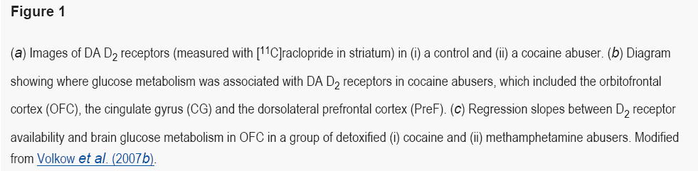
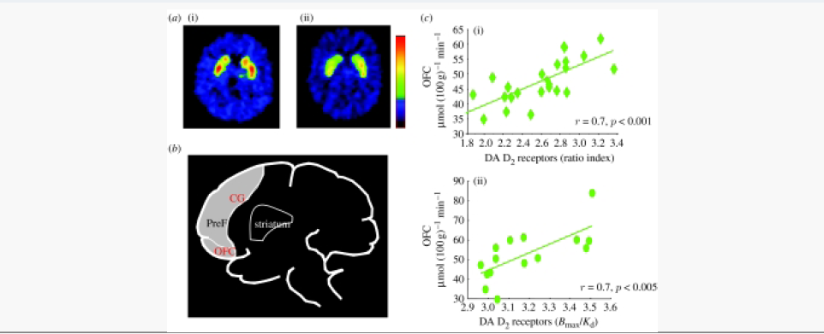
Published online 2008 July 24. doi: 10.1098/rstb.2008.0107.
Copyright © 2008 The Royal Society
 | food | drug
potency as a reinforcerª | ++ | oral, ++ snorted, +++ smoked, injected ++++
delivery | oral | oral, snorted, smoked, injected
mechanisms reward | somatosensory (palatability) chemical (glucose) | chemical (drug)
relevance of kinetics | not investigated | the faster the stimulation the more powerful its reinforcing effects
regulation of intake | peripheral and central factors | mostly central factors
adaptations | physiologic | supraphysiologic
physiological role | necessary for survival | unnecessary
learning | habits conditioned responses | habits conditioned responses
role of stress | +++ | +++

Slide 23
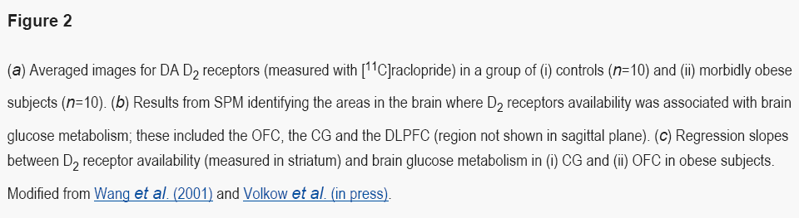
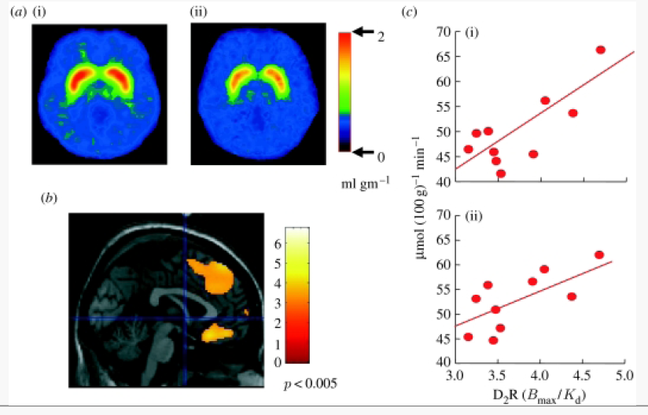

Slide 24
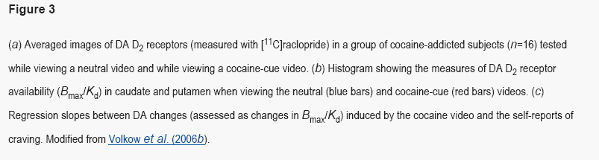
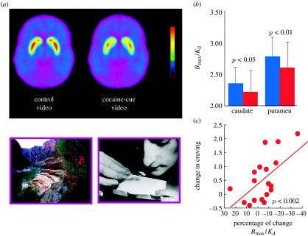

Slide 25
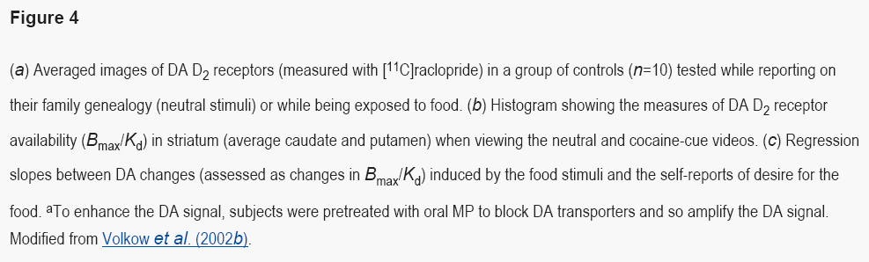
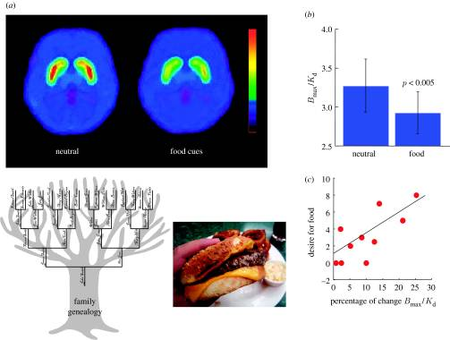

Slide 26
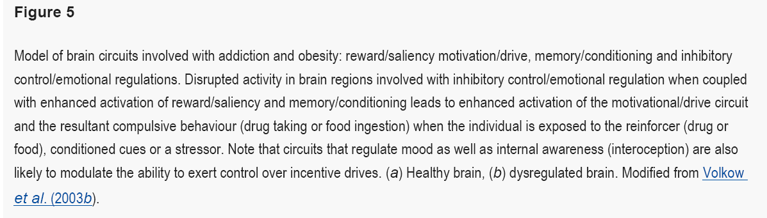
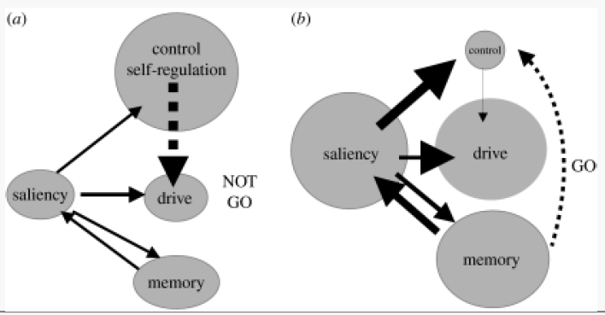

Slide 27
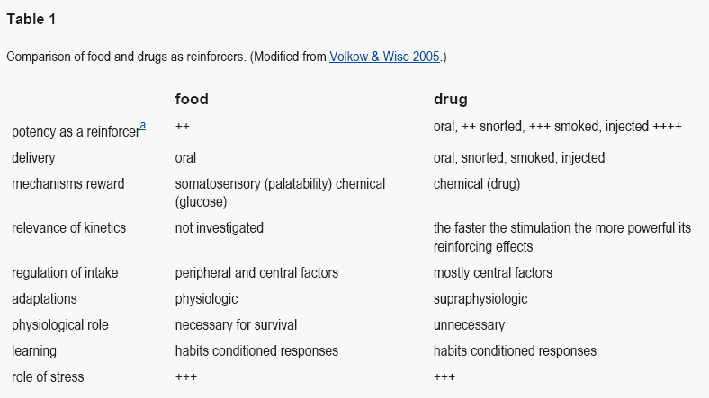

Slide 28
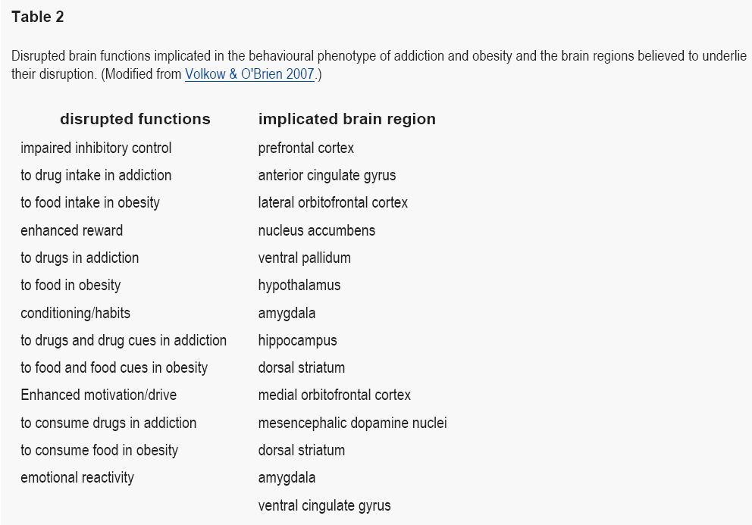

Slide 29
How does bypass surgery effect alcohol absorption
Gastric bypass surgery accounts for 75 percent of all bariatric surgeries in the US
There is a sectioning off of a small portion of the stomach of the stomach into a pouch that bypasses the first part of the small intestine.
Alcohol then is quickly absorbed in the jejunal portion of the small intestine

Slide 30
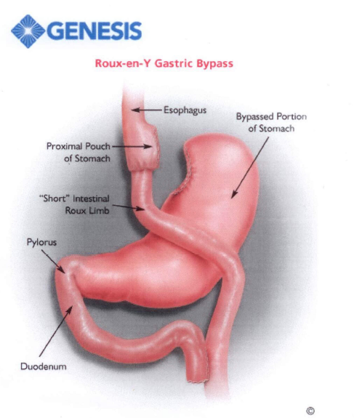

Slide 31
Tip of the Iceberg?
Quote by Dr Bankole Johnson of University of Virginia dept of Psychiatry says- “ Bypass surgery provides a mechanical solution that leaves the underlying neurobiological problem untreated.Its like thirst,If you are thirsty and there is no water you’ll drink lemonade

Slide 32
Normal absorption
Absorbed in stomach and upper and lower small intestine
Detoxified and converted to acetaldehyde then to acetate then co2 and water.
20 percent is absorbed in the stomach
Lungs and kidneys eliminate 5 percent
Liver eliminates 90 percent

Slide 33
absorption
Enhanced by carbonation
Warmth of the alcohol
Prementrual intake
Empty stomach

Slide 34
Gender differences
A woman who weighs the same as a man and drinks the same amt of alcohol will absorb 30% more alcohol and feel the psychoactive effects more quickly and more intensely ( normally takes 30-90 minutes for psychoactive effects to take place)
Women: less body water,less alcohol dehydrogenase in the stomach,cyclical hormonal changes

Slide 35
Changes in absorption post surgery
Stanford study 07-
Each gp drank 5 oz of red wine and had no food for two hrs
Control group had bal of .05 and required 72 min to return to 0
Bypass group reached level of .08 and required 108 minutes to return to normal

Slide 36
